Slide 1
Covering binary, decimal and hexadecimal
By
Charles Evert

Slide 2
Introduction
Counting begins at 0 not 1 with computers.
Therefore, counting from 1 to 10 is the same as counting from 0 to 9.
A base defines what (and how many) numbers (and/or letters) are used in counting
i.e. base 10 uses 0-9, binary(base 2) uses 0 and 1
The three more commonly used bases are base 2, base 10 and base 16. There is also base 8, but don’t worry about that right now.

Slide 3
Decimal
Otherwise known as base 10
This is the standard number system that we use everyday
Uses the numbers: 0 1 2 3 4 5 6 7 8 9
Examples: 101, 42, 6359

Slide 4
Binary
Otherwise known as base 2
This is the language of computers
Uses the numbers: 0 1
Examples: 0010, 101010, 1100110010100111

Slide 5
Hexadecimal
Otherwise known as base 16
Computers can also use this number system
Uses numbers and letters: 0 1 2 3 4 5 6 7 8 9 A B C D E F
Examples: 2A, 299, 34BD
Hexadecimal cannot represent a number greater than 9 and so uses letters to represent numbers 10 - 15. So,
A = 10 B = 11 C = 12 D = 13 E = 14 F = 15

Slide 6
Converting Decimal to Binary
To convert a decimal to binary we use the modulo operation.
Binary uses modulo 2, or mod 2 for short.
Mod 2 is the same as dividing a number by 2 and the remainder is what the binary form will be.
In mod 2, the only remainders will be a 0 or 1.
For example:
42 mod 2 = 0 because 42/2 = 21 with a remainder of 0
43 mod 2 = 1 because 43/2 = 21 with a remainder of 1

Slide 7
Converting Decimal to Binary
A decimal represented in binary means to keep dividing the quotient by 2 until the quotient is 0.
Example: Converting decimal 42 to binary
42 mod 2 = 0 Quotient = 21 Remainder = 0
21 mod 2 = 1 Quotient = 10 Remainder = 1
10 mod 2 = 0 Quotient = 5 Remainder = 0
5 mod 2 = 1 Quotient = 2 Remainder = 1
2 mod 2 = 0 Quotient = 1 Remainder = 0
1 mod 2 = 1 Quotient = 0 Remainder = 1
When complete, read/write the binary number from bottom to top.
Thus, the binary representation of decimal 42 is 101010

Slide 8
Converting Binary to Decimal
To convert binary to decimal, use the power notation with a base of 2.
Each position in a binary number is 2 to the power of the position. The first (zero) position is the right most position. The positions move from right to left.
So in 0101, the first position is the rightmost 1 (0101) then moves left.
A four bit binary number has positions 0, 1, 2, and 3 meaning that the first position(zero) is 2⁰ then 2¹ then 2² and finally 2³.
The value of 2⁰ = 1 and 2¹ = 2 and 2² = 4 and 2³ = 8 and so on.
Hint: notice how each position left doubles the value

Slide 9
Converting Binary to Decimal
So to convert binary to decimal multiply each position by the value of 1 or 0 then add it together.
Example: convert 101010 to decimal
Start with right most position(red) 101010 and multiply by 2⁰ then move left to next position (blue) and multiply by 2¹ and so on.
0x2⁰ + 1x2¹ + 0x2² + 1x2³ + 0x2⁴ + 1x2⁵
0x1 + 1x2 + 0x4 + 1x8 + 0x16 + 1x32
0 + 2 + 0 + 8 + 0 + 32
42
Thus, 101010 = 42 in decimal

Slide 10
Converting Decimal to Hexadecimal
A decimal represented in hexadecimal means to keep dividing the quotient by 16 until the quotient is 0. In mod 16, the remainder can be from 0 – 15.
Example: Converting decimal 42 to hexadecimal
42 mod 16 = 10 Quotient = 2 Remainder = 10
2 mod 16 = 2 Quotient = 0 Remainder = 2
When complete, read/write the hexadecimal number from bottom to top.
Hint: remember numbers 10 – 15 are represented by letters A – F.
Thus, the hexadecimal representation of decimal 42 is 2(10) = 2A

Slide 11
Converting Hexadecimal to Decimal
The same as converting binary to decimal, only with a base of 16.
So, start with right most position and move left.
Example: Convert hexadecimal 2A to decimal.
Remember A = 10
Ax16⁰ + 2x16¹ = 10x16⁰ + 2x16¹
10x1 + 2x16
10 + 32
42
Thus, 2A is 42 in decimal

Slide 12
Converting binary to hexadecimal
Converting binary to hexadecimal requires 8 or more bits divided into 4 bit segments. So, using our example of binary 101010, we add two 0s to the left most positions to create two 4 bit segments. These are known as placeholders.
101010 becomes 00101010
Dividing 00101010 into two segments we get 0010 and 1010.
If you know your binary numbers, then you know 0010 = 2 and 1010 = 10 or A in hexadecimal.
If you don’t know, then convert the segments from binary to decimal then from decimal into hexadecimal.
Thus, 00101010 = 2A in hexadecimal

Slide 13
Converting hexadecimal to binary
Converting hexadecimal to binary is creating 4 bit binary segments from the hexadecimal. In continuing with 2A, hexadecimal 2 is 0010 in binary and A (A = 10 in hexadecimal) is 1010.
This creates two segments of four bits 0010 and 1010.
Combine them into one 8 bit segment.
Thus, 2A = 00101010 or 101010 in binary

Slide 14
Helpful Charts
Decimal | Binary | Hex
0 | 0000 | 0
1 | 0001 | 1
2 | 0010 | 2
3 | 0011 | 3
4 | 0100 | 4
5 | 0101 | 5
6 | 0110 | 6
7 | 0111 | 7
8 | 1000 | 8
9 | 1001 | 9
10 | 1010 | A
11 | 1011 | B
12 | 1100 | C
13 | 1101 | D
14 | 1110 | E
15 | 1111 | F
 | base ^ power
 | base 2 | base 10 | base 16
0 | 1 | 1 | 1
1 | 2 | 10 | 16
2 | 4 | 100 | 256
3 | 8 | 1000 | 4096
4 | 16 | 10000 | 65536
5 | 32 | 100000 | 1048576
6 | 64 | 1000000 | 16777216
7 | 128 | 10000000 | 268435456
8 | 256 | 100000000 | 4294967296
9 | 512 | 1000000000 | 68719476736
10 | 1024 | 10000000000 | 1099511627776

Slide 15
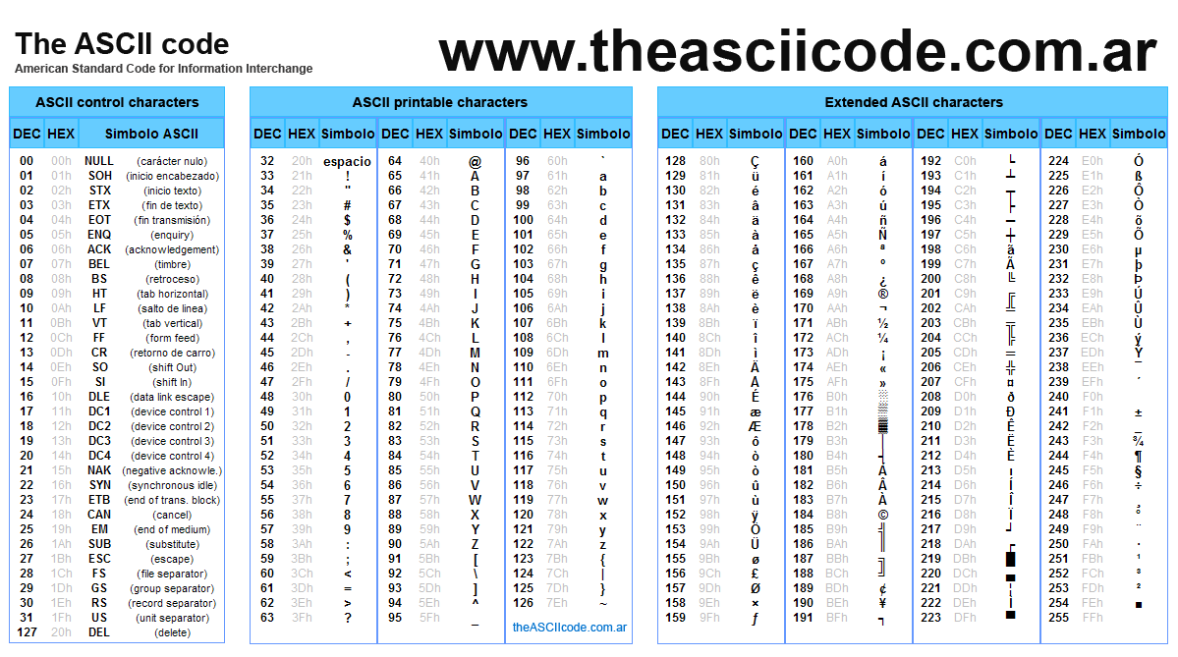
More Helpful Charts

Slide 16
Additional Example: Convert decimal 1234 into binary and hex
1234 mod 2 = 0 Quotient = 617 Remainder = 0 1234 mod 16 = 2 Quotient = 77 Remainder = 2
617 mod 2 = 1 Quotient = 308 Remainder = 1 77 mod 16 = 13 Quotient = 4 Remainder = 13
308 mod 2 = 0 Quotient = 154 Remainder = 0 4 mod 16 = 4 Quotient = 0 Remainder = 4
154 mod 2 = 0 Quotient = 77 Remainder = 0 4(13)2 = 4D2
77 mod 2 = 1 Quotient = 38 Remainder = 1 or
38 mod 2 = 0 Quotient = 19 Remainder = 0 10011010010 becomes 010011010010
19 mod 2 = 1 Quotient = 9 Remainder = 1 0100 1101 0010
9 mod 2 = 1 Quotient = 4 Remainder = 1 4 13 2
4 mod 2 = 0 Quotient = 2 Remainder = 0 4(13)2 = 4D2
2 mod 2 = 0 Quotient = 1 Remainder = 0
1 mod 2 = 1 Quotient = 0 Remainder = 1
1234 =10011010010

Slide 17
Additional Example: Convert 10011010010 and 4D2 into decimal
Binary to Decimal:
10011010010
0x2⁰ + 1x2¹ + 0x2² + 0x2³ + 1x2⁴ + 0x2⁵ + 1x2⁶ + 1x2⁷ + 0x2⁸ + 0x2⁹ + 0x2¹⁰
0x1 + 1x2 + 0x4 + 0x8 + 1x16 + 0x32 + 1x64 + 1x128 + 0x256 + 0x512 + 1x1024
0 + 2 + 0 + 0 + 16 + 0 + 64 + 128 + 0 + 0 + 1024
2+16+64+128+1024
1234
Hexadecimal to Decimal:
4D2 = 4(13)2
2x16⁰ + 13x16¹ + 4x16²
2x1 + 13x16 + 4x256
2 + 208 + 1024
1234

Slide 18
XOR operation
XOR is the exclusive OR operation.
In comparing bits, the XOR operation produces a 1 when one bit is a 1 and the other is a 0. The XOR will produce a 0 result when both bits are the same(both 1 or both 0)
It is also possible for the XOR operation to produce a 0 when the bits differ and a 1 if they are the same if the gate is set up that way. However, don’t worry about that yet.

Slide 19
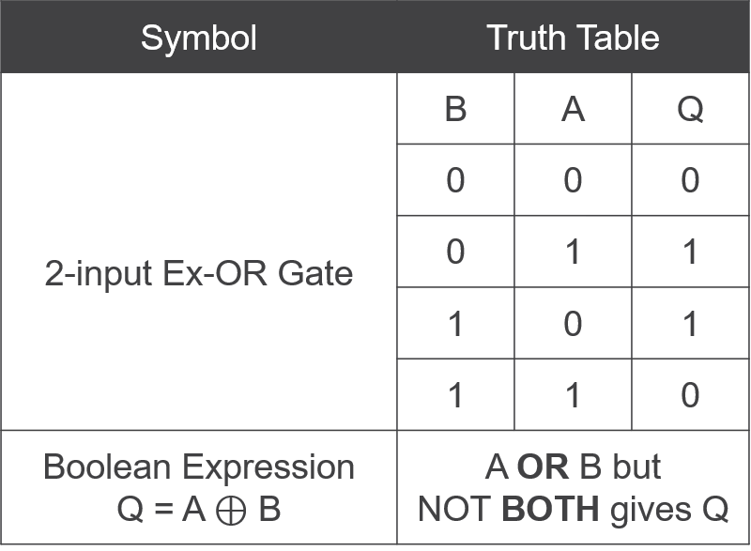

XOR operation
When comparing two inputs, the truth table (table of values) will look like this:

Slide 20
XOR Stream Cipher
The XOR Stream Cipher takes plaintext and encrypts it using the XOR operation.
In order to use the cipher, letters, numbers, and symbols must first be converted into binary. These results are what’s known as the ASCII code.
Example: Encrypt “HI” using the XOR cipher with the key = 42
H has a hex value of 48 (from ASCII table) which converted to binary is 01001000
I has a hex value of 49 which converted to binary is 01001001
42 has a hex value 2A which converted to binary is 00101010
H 0100 1000 I 0100 1001
(key)XOR 0010 1010 (key)XOR 0010 1010
Cipher 0110 0010 Cipher 0110 0011
So 01100010 has a hex value of 62 which is the symbol for “b” (from ASCII table)
So 01100011 has a hex value of 63 which is the symbol for “c”
Thus, “HI” encrypted is “bc” with a key of 42.

Slide 21
QUESTIONS?

